Slide 1

New
Water & Wastewater
Utility Services
Rates
Effective Sept. 2026
NTUA Report to
Naabik’íyáti’ Committee
25th Navajo Nation Council
August 13, 2026

Slide 2
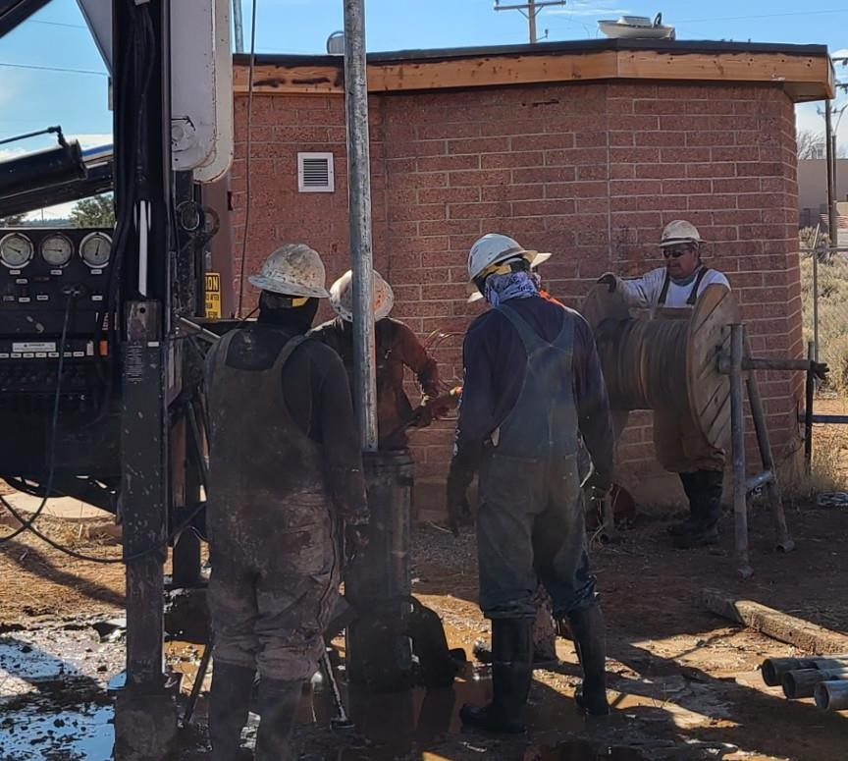
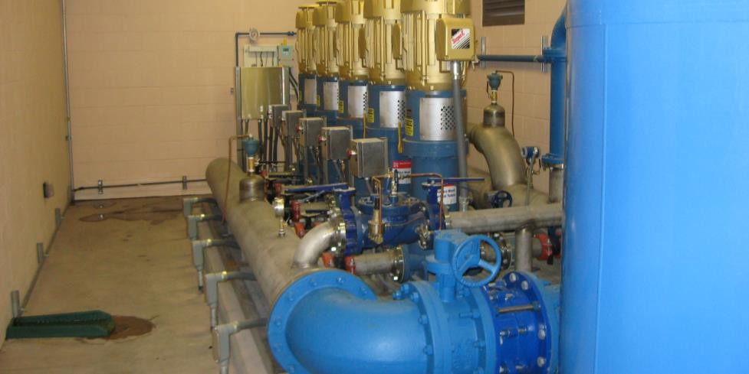
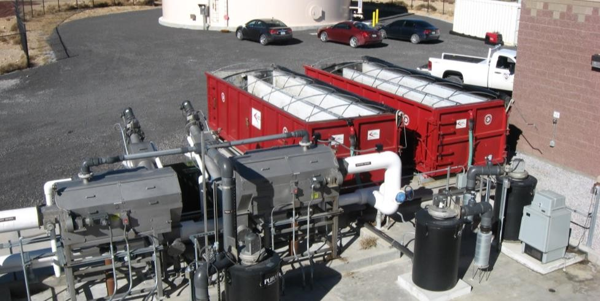
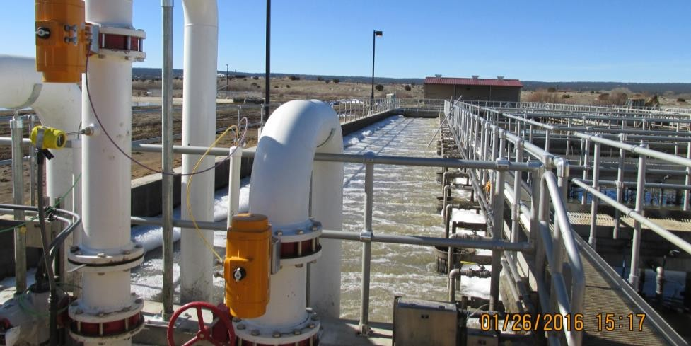
What it takes to provide Safe, Reliable Water & Wastewater
Services
Distribution Treatment
Sewer Collection WW Treatment
2

Slide 3
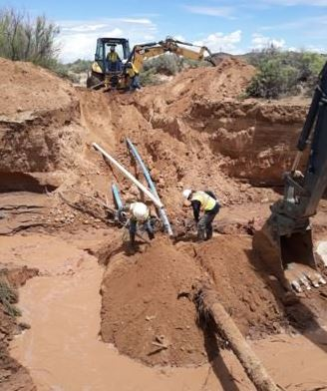
NTUA Water Service Area
96 Stand-Alone Water Utility Systems
3 Water Treatment Plants
332 Water Wells with Treatment
127 Booster Stations
363 Storage Tanks
7,567 Miles of Water Main Lines
790 Miles of Service Lines
40,719 Water Customers

Slide 4

NTUA Wastewater Service Area
111 Stand-Alone Wastewater Systems
9 Wastewater Discharging Treatment Plants
102 Non-Discharging Lagoons
371 Miles of Wastewater Collection
13,956 Wastewater Customers

Slide 5
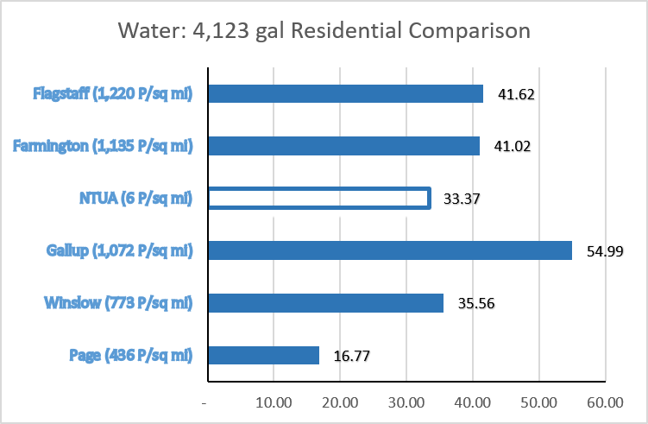
How do NTUA 7/2026 Water Rates Compare in Region?
Note: NTUA has less than 6 water customers per mile of water main
By Comparison Flagstaff has over 51 water customers per mile of water main –
nearly 10x more dense

Slide 6
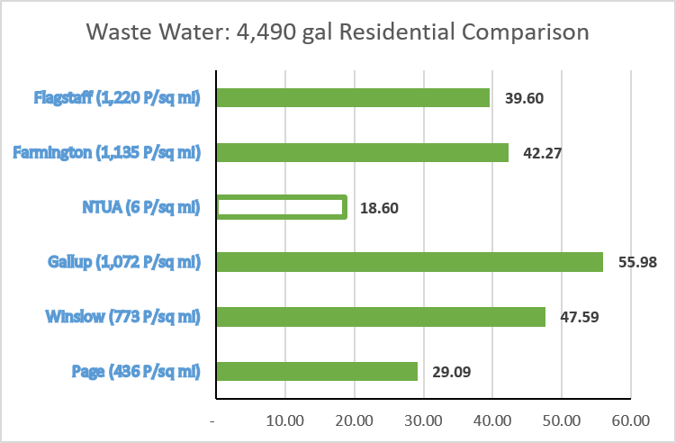
How do NTUA 7/2026 Wastewater Rates Compare in the Region?

Slide 7
NTUA Rate Analysis and Public Meetings
In 2025 NTUA contracted with NewGen Strategies and Solutions
Nationally recognized independent financial and economic consulting firm
Performed a financial cost of service study of NTUA’s water and wastewater services
NewGen Strategies developed two different proposals to increase rates in four phases over a three-year period to cover NTUA’s costs of service
NTUA Management Board approved commencement of public information meetings
April, May and June, 2026, 12 Public Information meetings held throughout the NTUA service territory
A total of 175 people out of 54,675 Water/Wastewater Services customers attended the 12 meetings (some customers attended multiple meetings)
Formal Public Hearing – June 17, 2026, at the Navajo Nation Museum, Window Rock, AZ

Slide 8
NTUA 12 Public Meetings & Formal Public Hearing
Locations | Dates
Chinle NTUA District Office | March 17, 2026
Tuba City Chapter House | March 24, 2026
NTUA Crownpoint Office | March 31, 2026
Kayenta Chapter House | April 7, 2026
NTUA Dilkon District | April 14, 2026
Phil Thomas Performance Center in Shiprock | April 21, 2026
Window Rock Cinema | April 28, 2026
Crownpoint Chapter House | May 13, 2026
Pinedale Chapter | May 18, 2026
Navajo Nation Museum | May 21, 2026
Shiprock, NM | June 3, 2026
Chinle NTUA District Office | June 8, 2026
Formal Public Hearing – Window Rock, AZ | June 17, 2026

Slide 9
Public Comments - Major Themes Identified
Theme | Summary | Frequency
Rate Increase Concerns | Questions regarding cumulative increases, timing, and customer affordability. | 38
Infrastructure & Maintenance | Questions about projects (repairs, upgrades, replacement projects, and system maintenance). | 34
Transparency & Communication | Requests for clearer explanations regarding planning, costs, and revenue allocation. | 29
Supportive / Understanding | Some customers acknowledged the need for infrastructure improvements. | 27
Affordability & Fixed Income | Concerns regarding impacts to elders, retirees, and fixed-income households. | 26
Operational & Staffing | Questions regarding staffing levels, budgeting, and operational efficiency. | 21
Water Quality & Reliability | Concerns regarding water quality, pressure, reliability, and safe drinking water. | 8
Total Questions Asked |  | 183

Slide 10
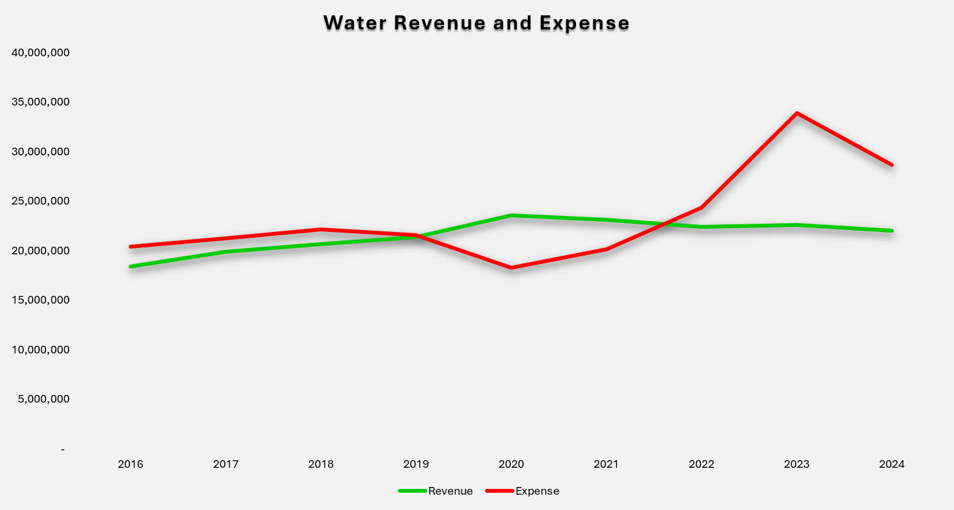
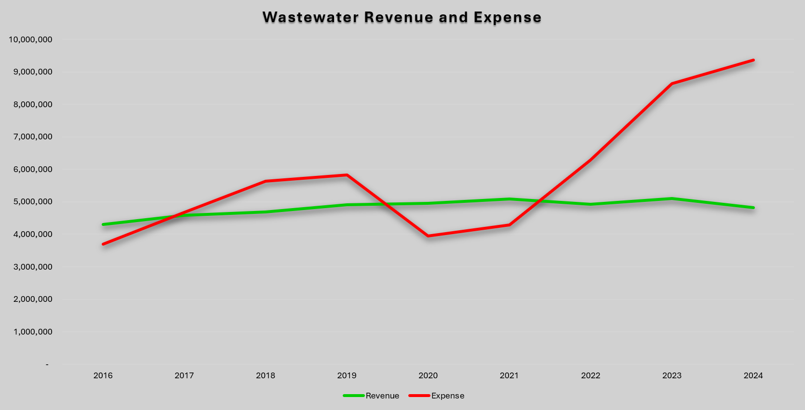
Revenue Gap
Revenue Gap – NTUA Water/Wastewater Operations
Rising Costs & Aging Infrastructure
Expenses increasing faster than revenue
Utilities become unsustainable without action
Water and Wastewater rates have not been adjusted to cover increased costs during the last 6 years
Water and Wastewater rates were last adjusted in 2020

Slide 11
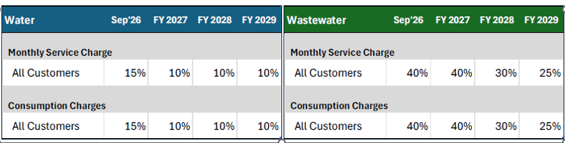
As a result of Rates not being adjusted to cover growing costs,
water operations expenses exceeded revenues by $6,649,550 in 2025
wastewater operations expenses exceeded revenues by $2,057,948 in 2025
On June 17, 2026, the NTUA Management Board approved rate increases in four phases over a three-year period to produce revenues to cover the rising costs of providing water and wastewater services

Slide 12
The average residential water customer on the NTUA system uses approximately 4,123 gallons per month –
about 133 gallons of Water each day
Standard Water Rate Average Customer Monthly Cost (Including Navajo Nation 6% Sales Tax) *Effective September 2026
 | 2025 | 2026* | 2027 | 2028 | 2029
Avg Monthly Bill | $ 35.37 | $ 40.68 | $ 44.75 | $ 49.22 | $ 54.14
Increase From Prior Year | $ - | $ 5.31 | $ 4.07 | $ 4.47 | $ 4.92
Cost Per Day for 133 gallons | $ 1.18 | $ 1.36 | $ 1.49 | $ 1.64 | $ 1.80

Slide 13
Lifeline/Senior Discounted Water Rate Average Customer Monthly Cost using approximately 4,123 gallons per month – about 133 gallons of Water each day (Including Navajo Nation 6% Sales Tax) *Effective September 2026
 | 2025 | 2026* | 2027 | 2028 | 2029
Avg Monthly Bill | $ 19.06 | $ 24.08 | $ 26.49 | $ 29.14 | $ 32.08
Increase From Prior Year | $ - | $ 5.02 | $ 2.41 | $ 2.65 | $ 2.94
Cost Per Day for 133 gallons | $ 0.64 | $ 0.80 | $ 0.88 | $ 0.97 | $ 1.07
No other utilities in the region offer a Lifeline or Senior Discount

Slide 14
The average residential wastewater customer on the NTUA system disposes of approximately 4,490 gallons per month,
which is about 150 gallons each day
Standard Wastewater Rate Average Customer Monthly Cost (Including Navajo Nation 6% Sales Tax) *Effective September 2026
 | 2025 | 2026* | 2027 | 2028 | 2029
Avg Monthly Bill | $ 19.71 | $ 27.60 | $ 38.64 | $ 50.23 | $ 62.79
Increase From Prior Year | $ - | $ 7.89 | $ 11.04 | $ 11.59 | $ 12.56
Cost Per Day for 150 gallons | $ 0.66 | $ 0.92 | $ 1.29 | $ 1.67 | $ 2.09

Slide 15
Lifeline/Senior Discounted Wastewater Rate Average Customer Monthly Cost Disposing of 4,490 Gallons per month – 150 gallons each day (Including Navajo Nation 6% Sales Tax) *Effective September 2026
 | 2025 | 2026* | 2027 | 2028 | 2029
Avg Monthly Bill | $ 10.70 | $ 16.36 | $ 22.90 | $ 29.78 | $ 37.21
Increase From Prior Year | $ - | $ 5.66 | $ 6.54 | $ 6.87 | $ 7.43
Charge Per Day for 150 gallons | $ 0.36 | $ 0.55 | $ 0.76 | $ 0.99 | $ 1.24

Slide 16
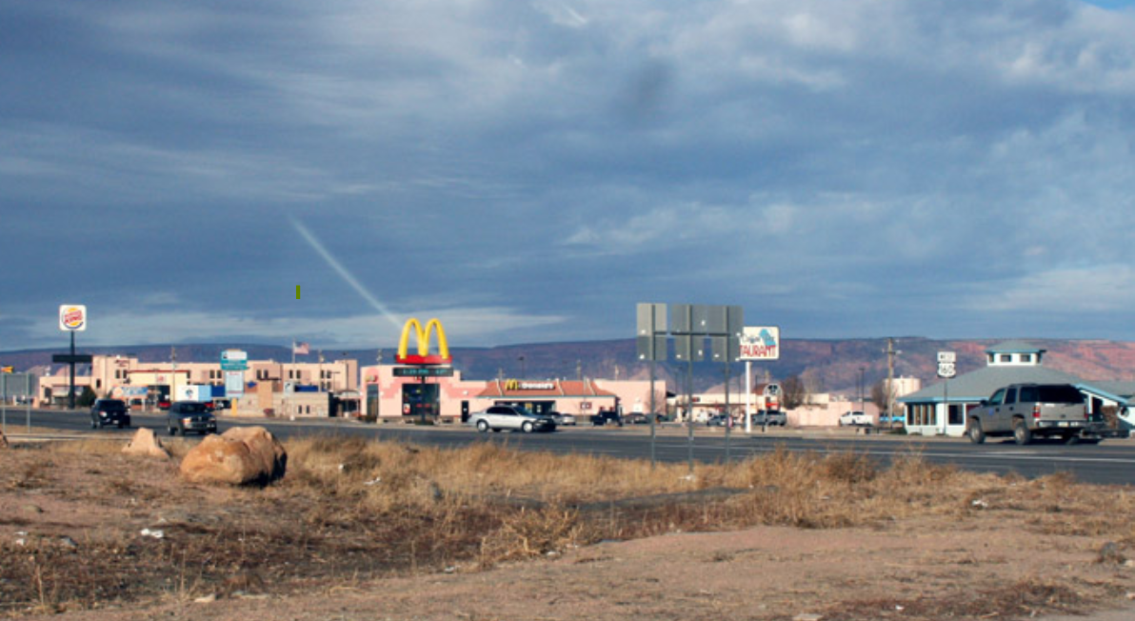
New Water & Wastewater rates for Non-residential customers
All nonresidential water customers, such as commercial, industrial, and government offices, will see a 15% rate increase to the service charge and the usage charges effective September 2026. They will also see additional 10% increases on January 1, 2027, January 1, 2028, and January 1, 2029.
All nonresidential wastewater customers, such as commercial, industrial, and government offices, will see 40% rate increase for both service charge and usage charges effective September 2026. They will then see an increases of 40% on January 1, 2027, 30% on January 1, 2028, and 25% on January 1, 2029.

Slide 17

New Income Limit for Seniors
Rate meetings: primary concerns of Senior Citizens on fixed income
NTUA Board approved to increase the income limit for eligibility for Senior Citizens age 60 and over
The new income limit is $29,130, or less, an increase from the current limit of $21,000, or less
Applies to all NTUA utility services
The monthly service charges for water and wastewater customers receiving the Senior Citizen Discounted rates and the Lifeline Support discounted rates are also adjusted, going from $3.00 per month to $5.50 per month effective September 1, 2026.

Slide 18
NTUA Senior Discount – Eligibility Expanded
Management Board adopted this adjustment selected as the residential utility rate subsidy eligibility threshold because it:
Is based on income data representative of the Navajo Nation
  80% of $36,413 Median Income on Navajo Nation
Uses a nationally recognized federal low-income standard
Reflects the overall economic conditions of Navajo Nation households
Provides a more inclusive threshold for assisting elderly households living on fixed incomes while maintaining consistency with other federal assistance programs
Establishes a fair, transparent, and easily administered eligibility criterion for the residential utility rate subsidy program

Slide 19
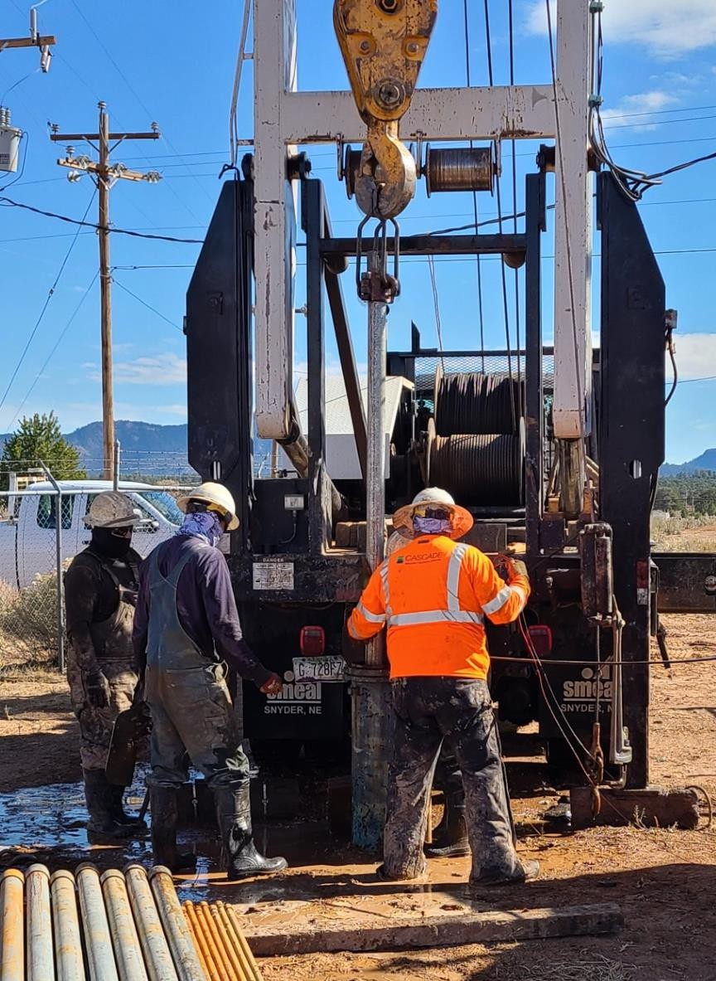
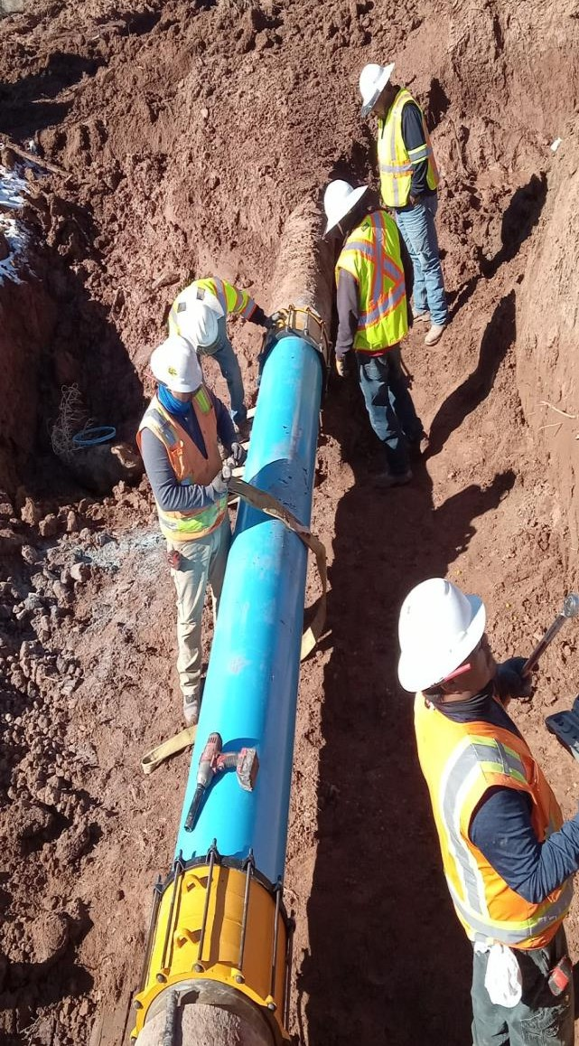
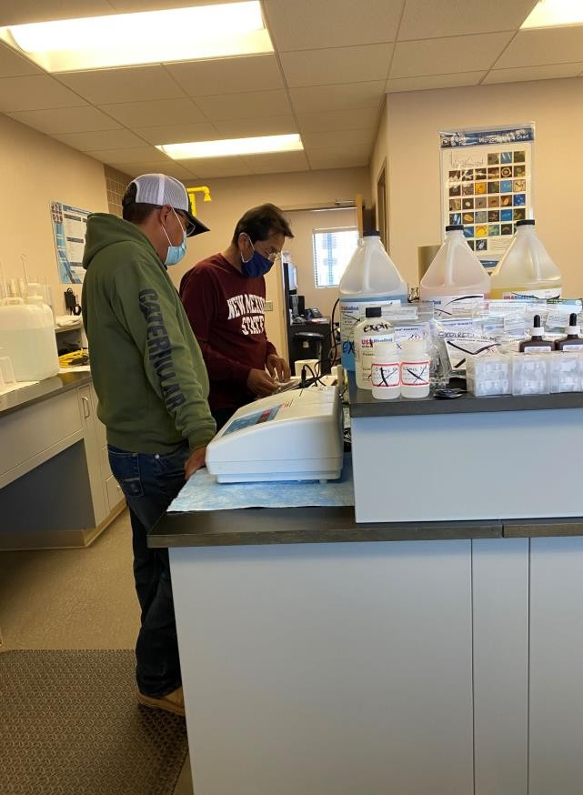
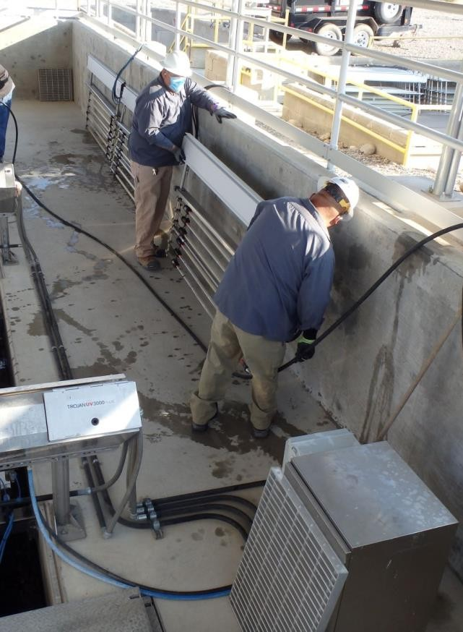
New Water and Wastewater rates prepare NTUA for what’s ahead
Like the rest of the country, NTUA has been experiencing rising costs for expenses, such as equipment, materials, maintenance, fuel, labor, environmental compliance, and replacement costs of their water distribution, water wells, water tanks, and water treatment systems, and wastewater collection and wastewater treatment systems

